Slide 1


设计模式 访问者模式 Design Pattern - Visitor pattern
杨茂林 kylin@hust.edu.cn

Slide 2
Visitor Pattern Overview
The visitor design pattern is a way of separating an algorithm from an object structure on which it operates.
A practical result of this separation is the ability to add new operations to existing object structures without modifying the structures.
The visitor allows adding new virtual functions to a family of classes, without modifying the classes. Instead, a visitor class is created that implements all of the appropriate specializations of the virtual function. The visitor takes the instance reference as input, and implements the goal through double dispatch.

Slide 3
Definition
Represent an operation to be performed on elements of an object structure without changing the classes of the elements on which it operates (The Gang of Four ).
How to …?
Define a separate (visitor) object that implements an operation to be performed on elements of an object structure.
Clients traverse the object structure and call a dispatching operation accept (visitor) on an element — that "dispatches" (delegates) the request to the "accepted visitor object". The visitor object then performs the operation on the element ("visits the element").

Slide 4
Advantages
Many unrelated operations on an object structure are required,
The classes that make up the object structure are known and not expected to change,
New operations need to be added frequently,
An algorithm involves several classes of the object structure, but it is desired to manage it in one single location,
An algorithm needs to work across several independent class hierarchies.
Drawback
New classes typically require a new visit method to be added to each visitor.

Slide 5
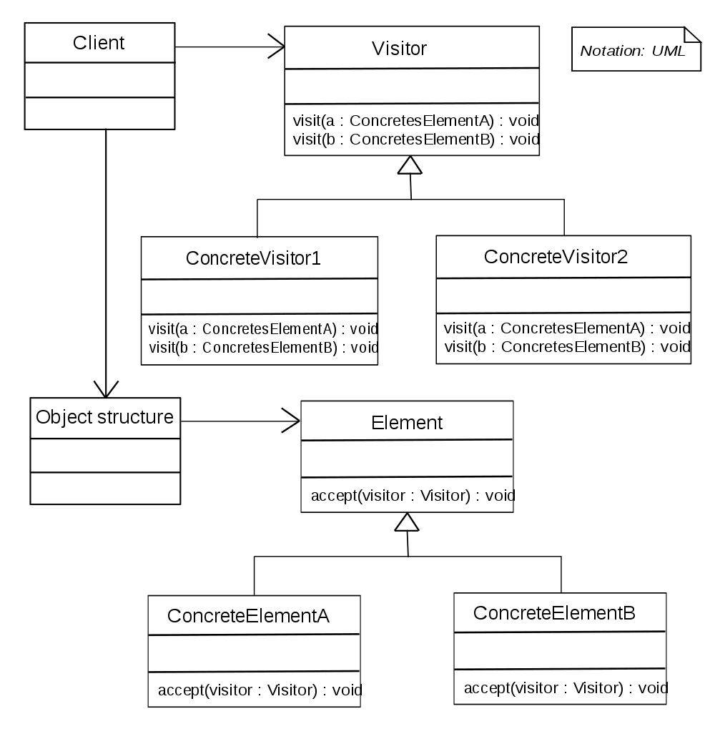
Sample Class Diagram

Slide 6
访问者模式要点：
被访问对象类都有accept方法用来接受访问者对象
ElementA.accept(Visitor V) {V.visit(this);}
ElementB.accept(Visitor V) {V.visit(this);}
访问者有visit方法,对不同类型的对象作不同操作
ConcreteVisitor.visit(ElementA) { }
ConcreteVisitor.visit(ElementB) { }

Slide 7
访问者模式举例
Exp
AddExp
+
.
├── CMakeLists.txt
├── include
│ ├── Exp.h
│ └── Visitor.h
└── src
├── Visitor.cpp
└── main.cpp
AddExp
+
4
AddExp
IntExp
+
3
IntExp
1
2
IntExp
IntExp

Slide 8
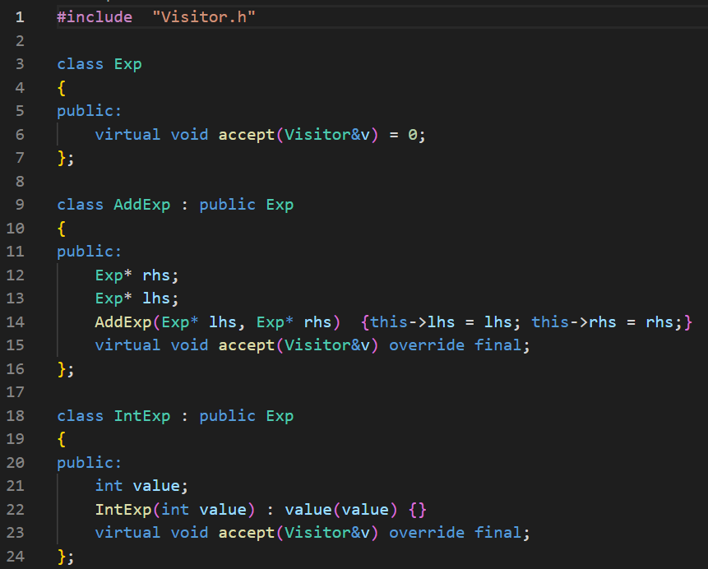
Exp.h

Slide 9
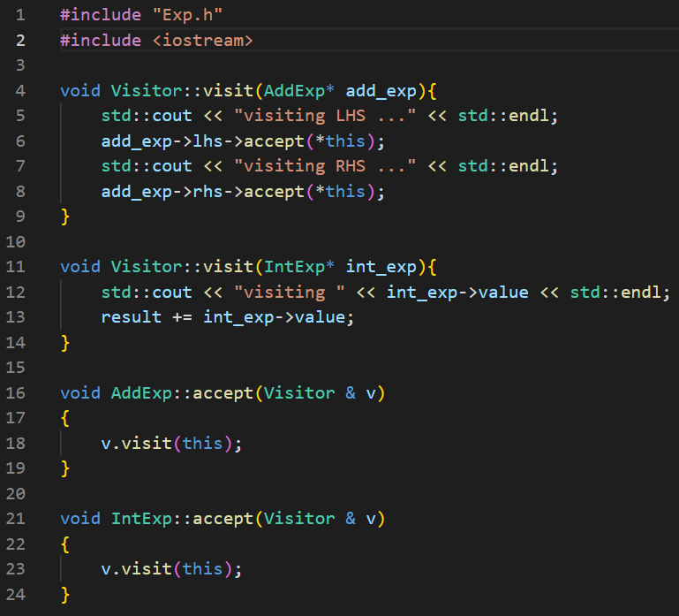
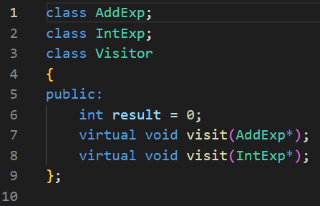
Visitor.h
Visitor.cpp

Slide 10
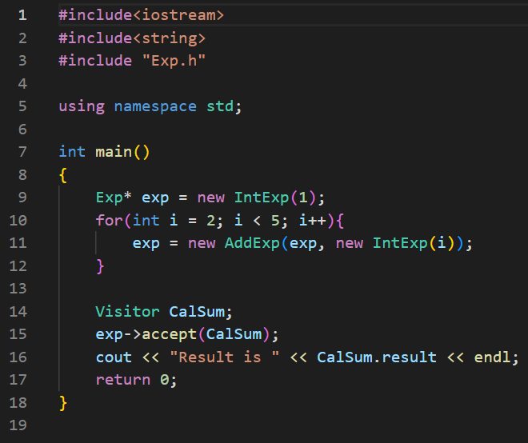
main.cpp
Exp
AddExp
+
AddExp
+
4
AddExp
IntExp
+
3
IntExp
1
2
IntExp
IntExp

Slide 11
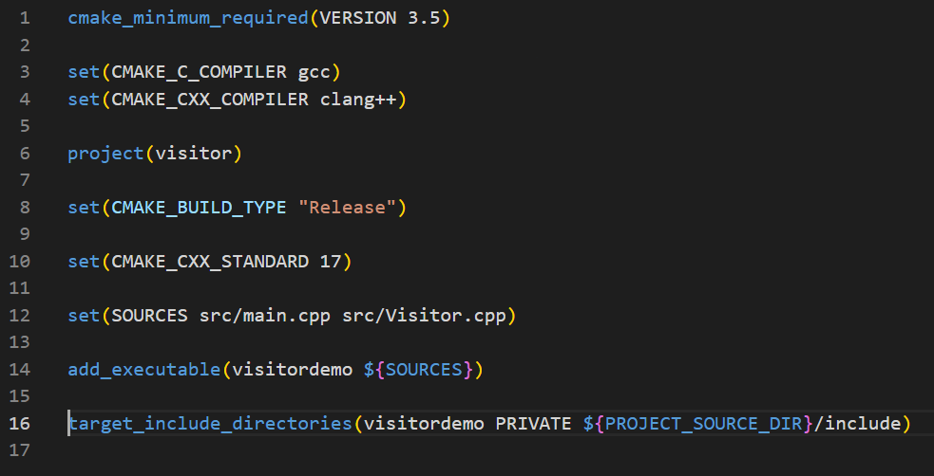
CMakeLists.txt

Slide 12
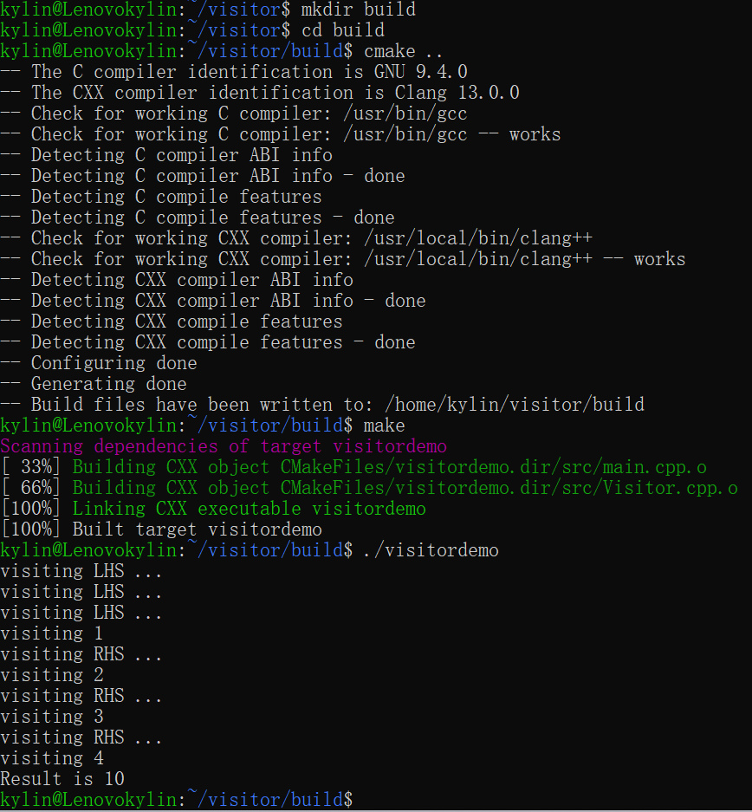
编译并运行
Exp
AddExp
+
AddExp
+
4
AddExp
IntExp
+
3
IntExp
1
2
IntExp
IntExp

Slide 13
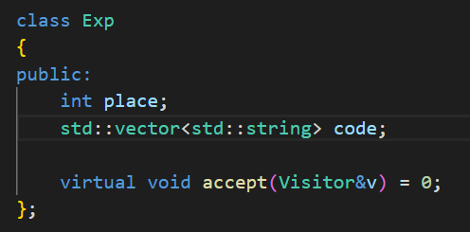
进一步改进：生成计算表达式的三地址码
为Exp增加属性
place
code

Slide 14
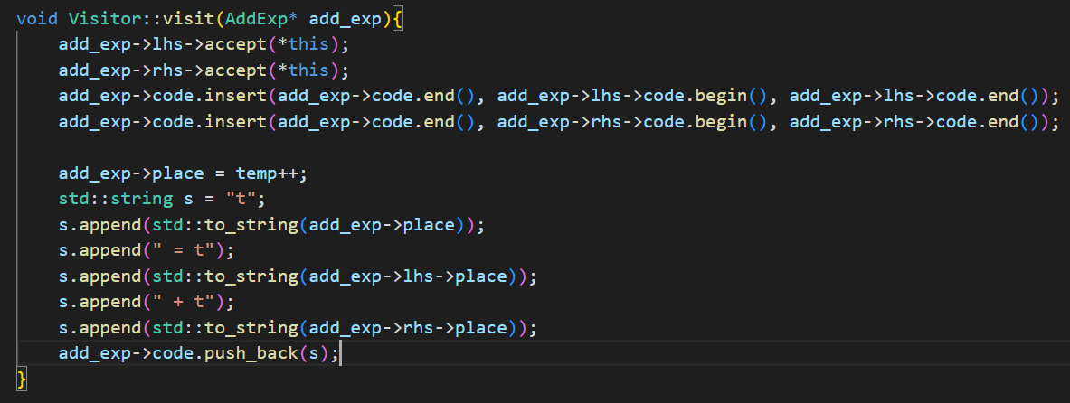
进一步改进：生成计算表达式的三地址码
综合属性的计算

Slide 15
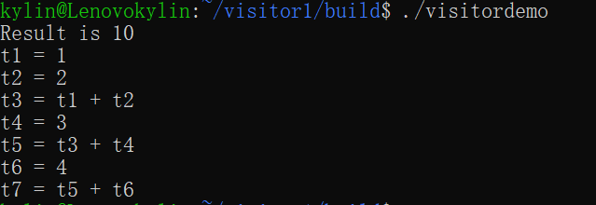
编译运行
Exp
AddExp
+
AddExp
+
4
AddExp
IntExp
+
3
IntExp
1
2
IntExp
IntExp

